Slide 1
Spark on HDInsight
Ingyu Lee
Troy University
https://github.com/Azure-Bootcamp-Troy/SparkInHDInsight

Slide 2
Content
What is Spark on HDInsight?
Demo: Create Spark Cluster on Azure
What is an RDD, DataFrames, Spark SQL?
Demo: Operations of RDD, DataFrames and SQL
What is MLlib?
Demo: Machine Learning using Spark
For Whom this talk
Business users to analyze Big Data using Spark on Azure Cluster.
Prerequisite
None

Slide 3
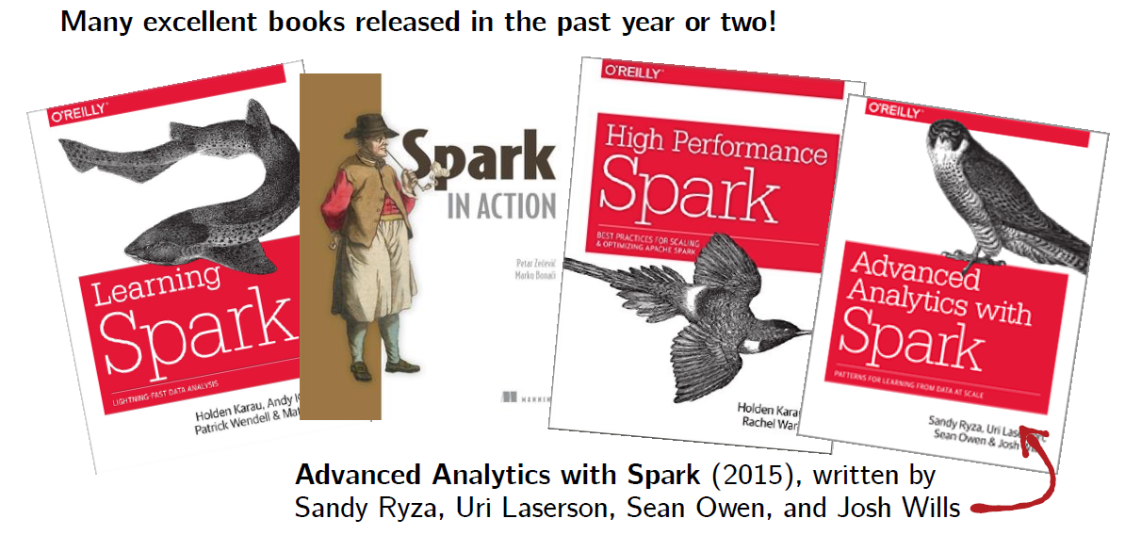
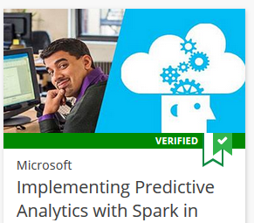
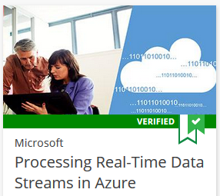
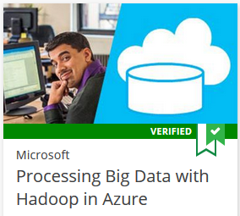
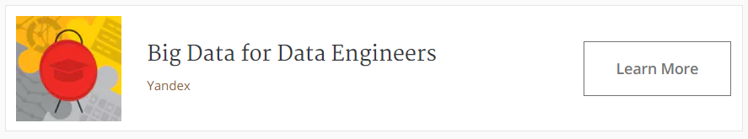
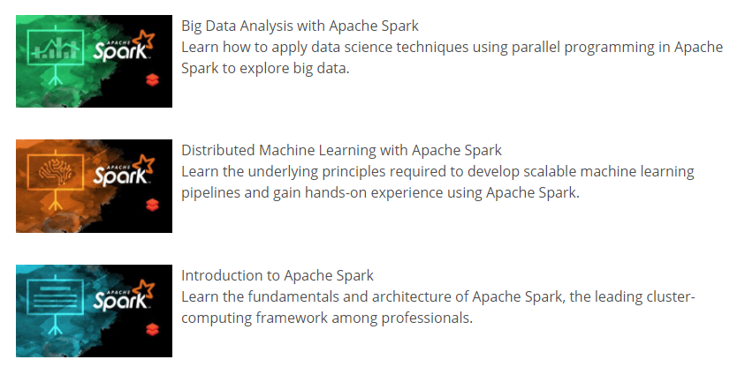
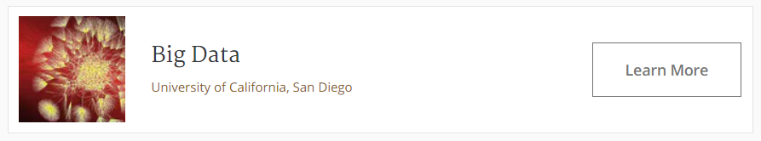
References
This talk is based on this course

Slide 4
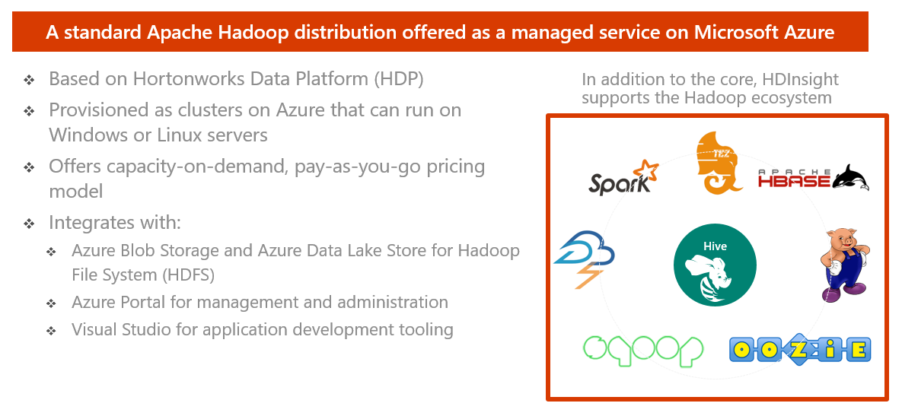
HDInsight – What is it?

Slide 5
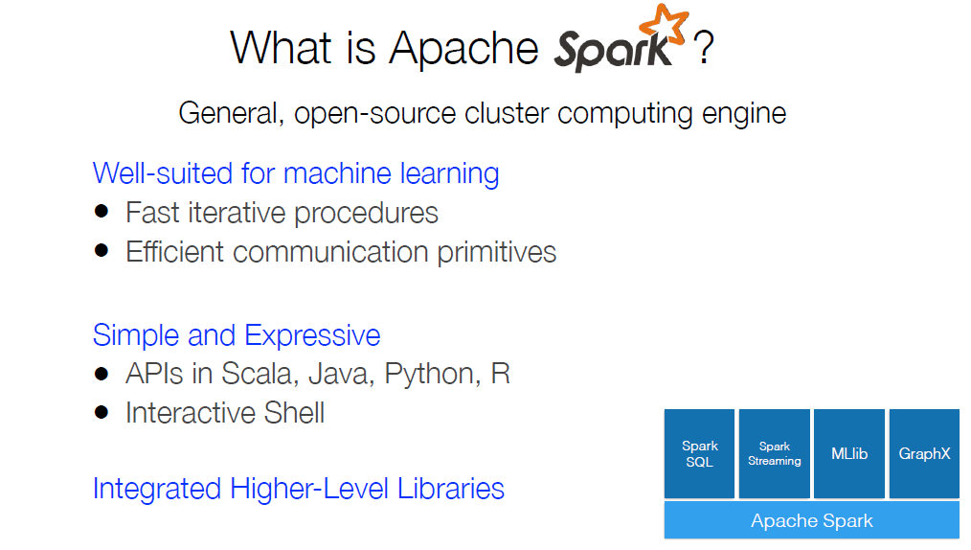
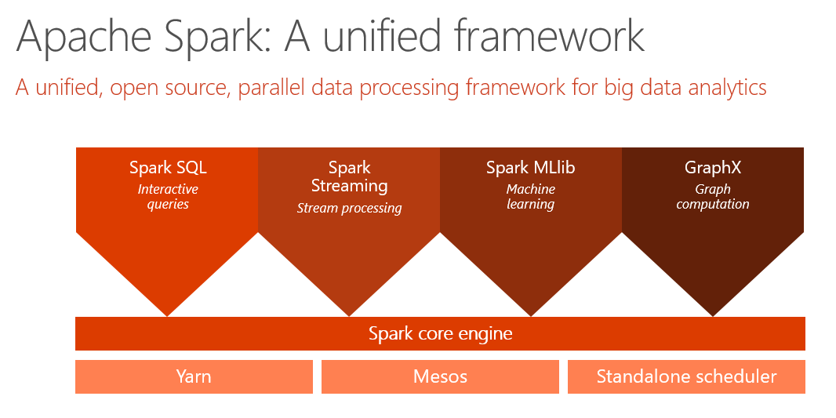

Slide 6
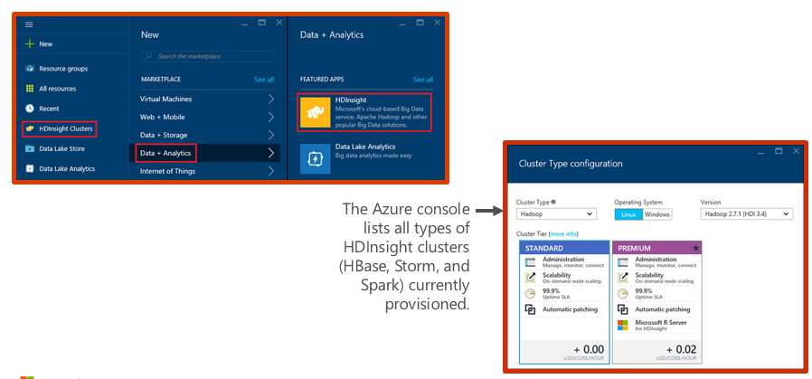
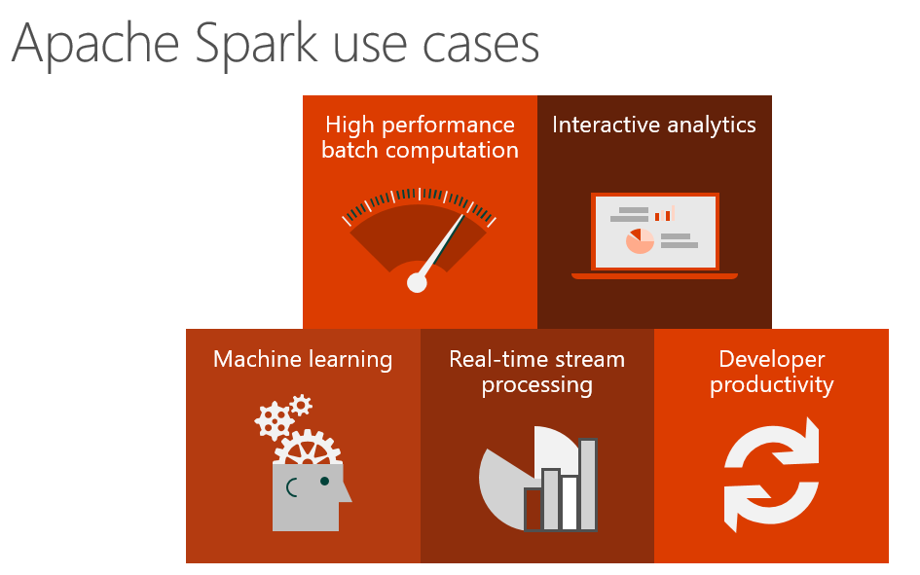
Demo: Creating an HDInsight Spark cluster

Slide 7
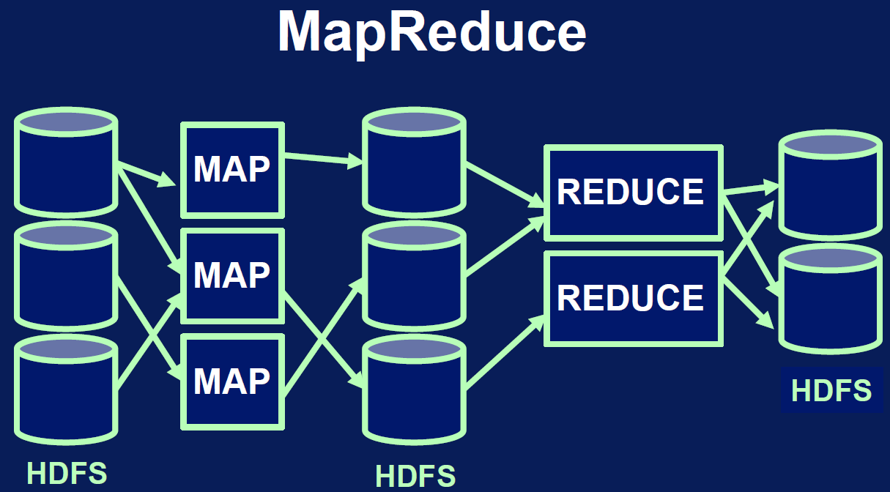
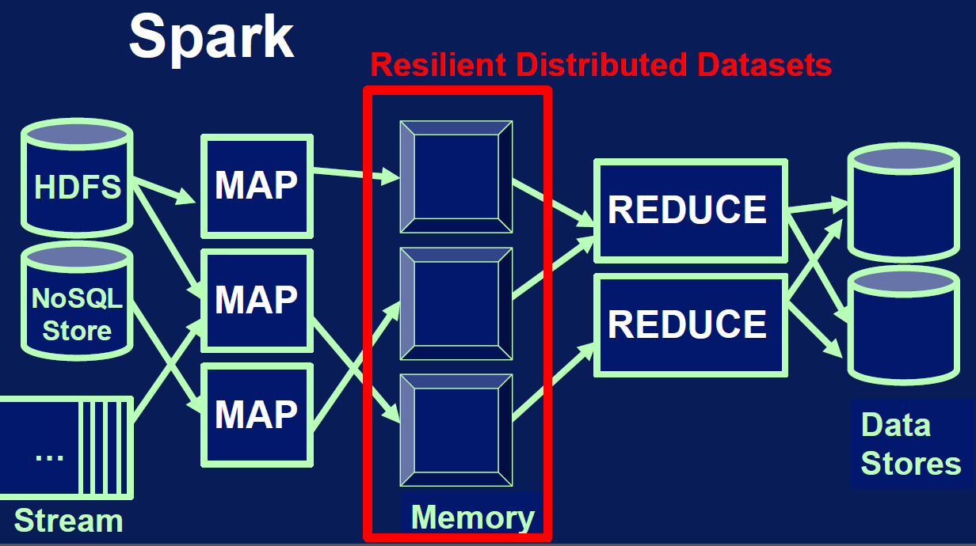
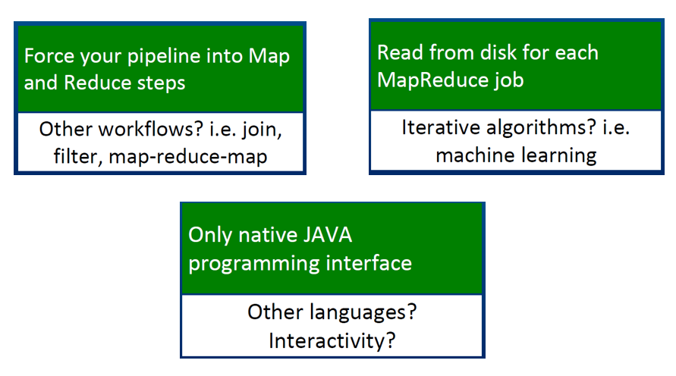
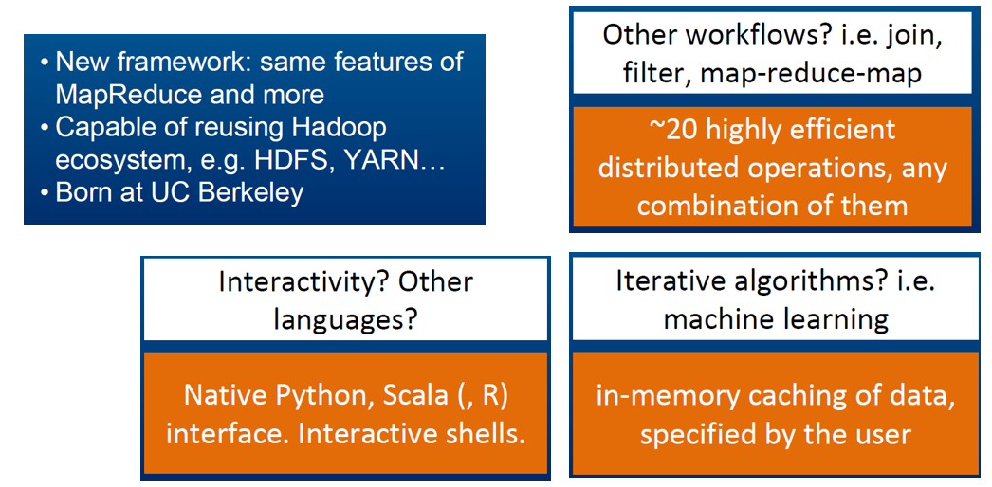
Hadoop vs. Spark

Slide 8
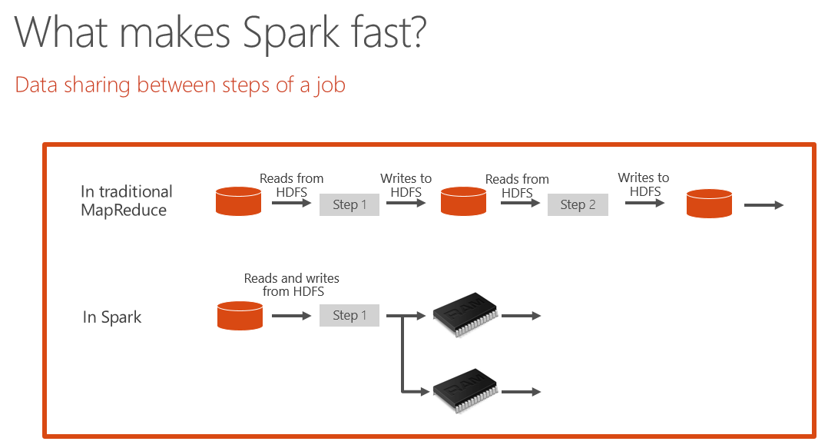
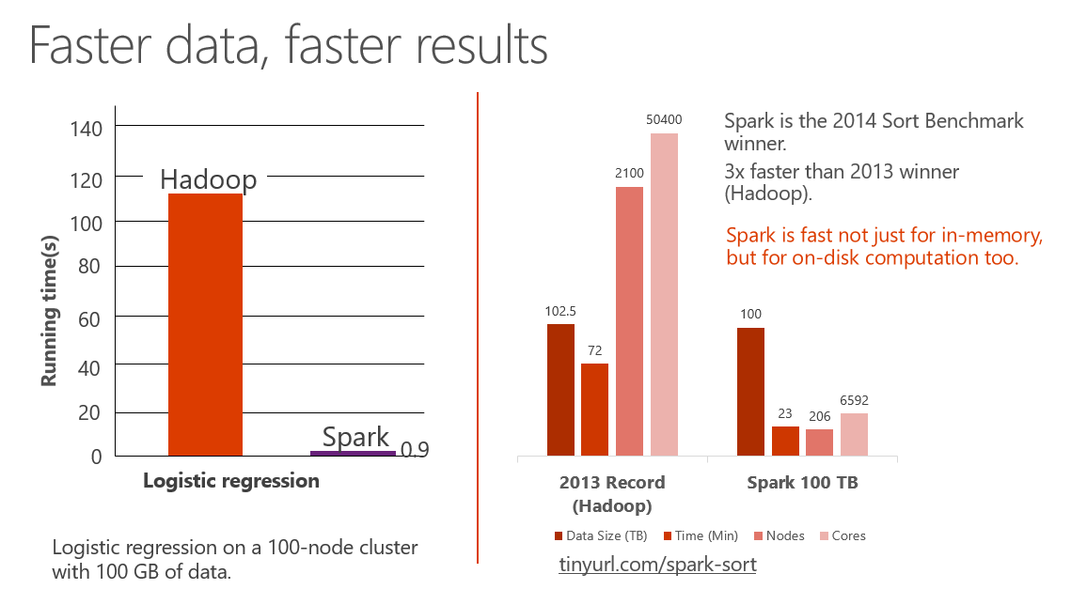
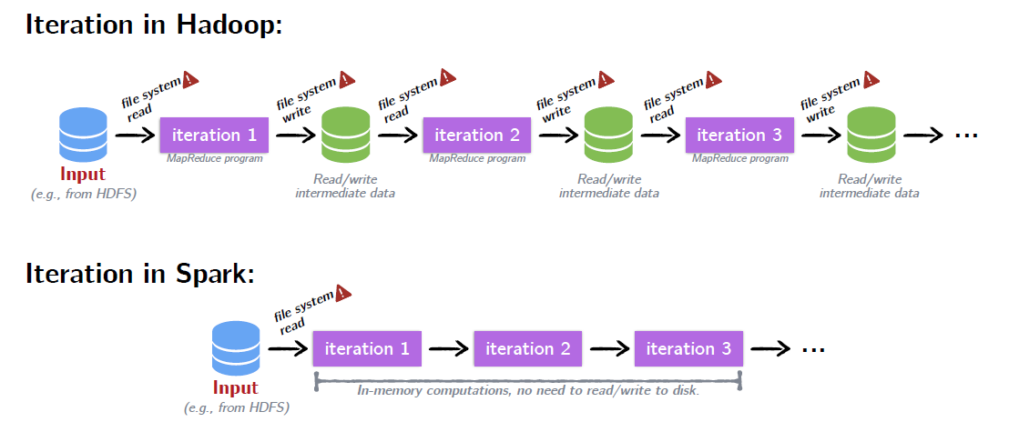
Why sparks is faster?

Slide 9
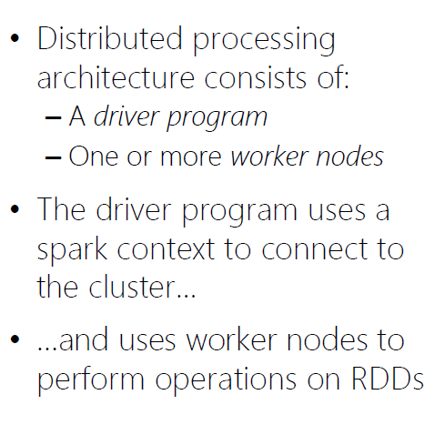
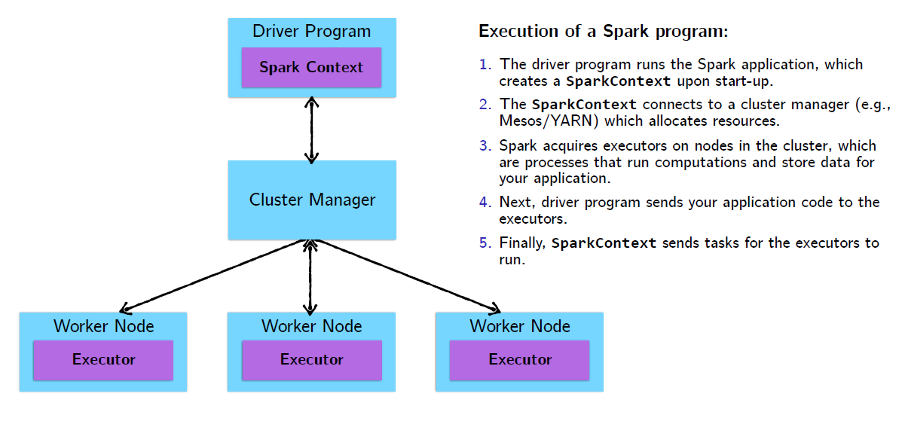
Spark cluster architecture

Slide 10
Cluster
Worker node 1
Browser
Gateway
Spark submit
Zeppelin
Jupyter
Worker 1
Job
Task
Task
Worker node 2
Head node
Worker 2
Job
Task
Spark master
Task
App 0
App 1
App 2
Worker node 3
Worker 3
Job
Task
Task
Spark driver
RDD
Worker node 4
Spark context
Worker 4
Job
Task
RDD
Task
This is just an example, worker node capacity is much greater than 4 nodes

Slide 11
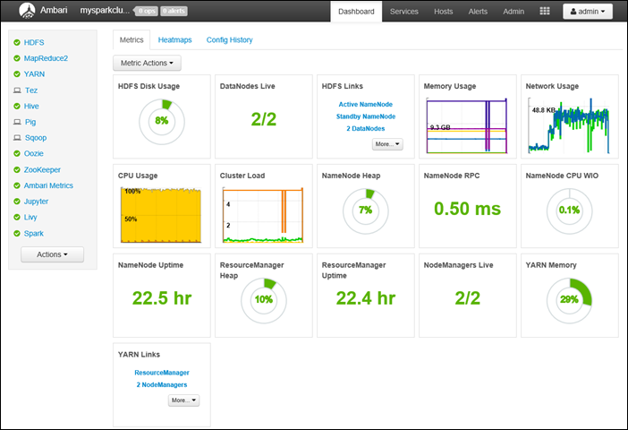
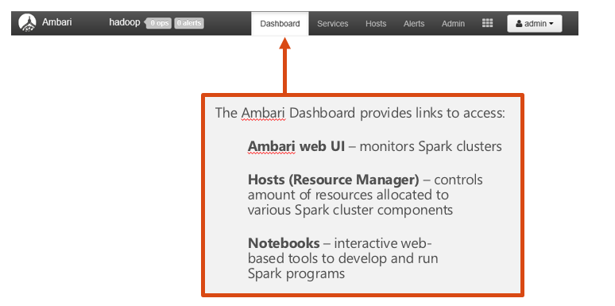
Demo: Ambari Dashboard

Slide 12
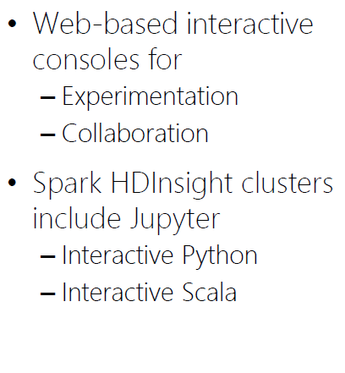
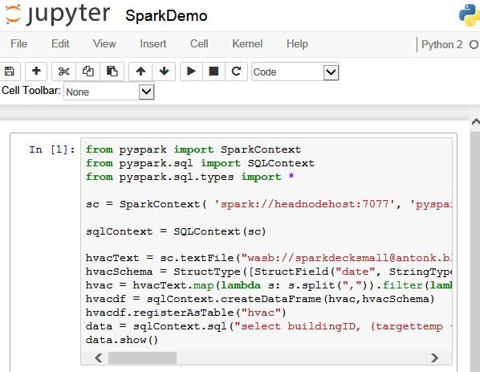
Demo: Jupyter notebooks

Slide 13
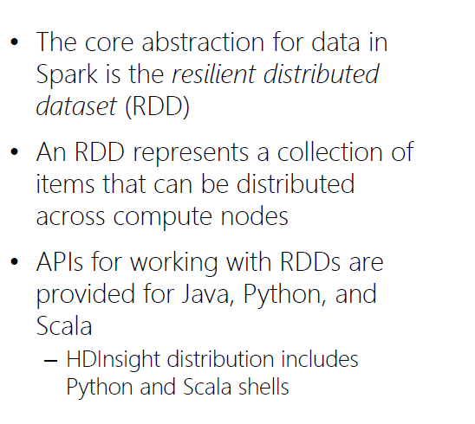
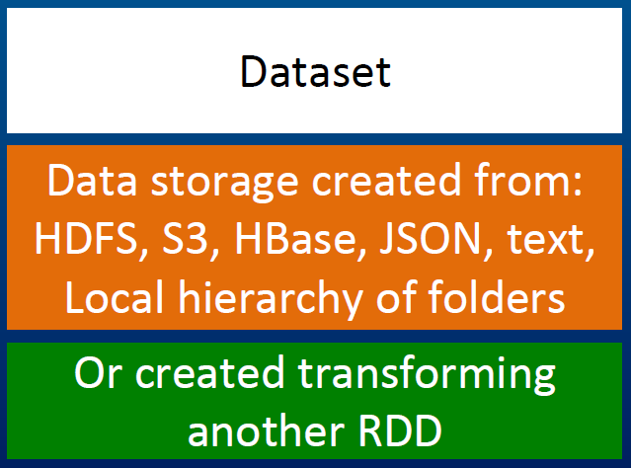
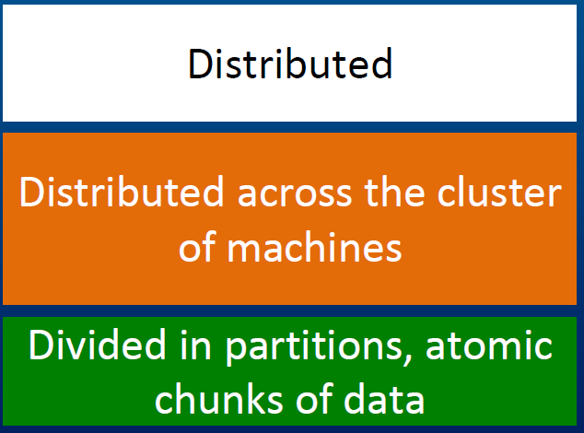
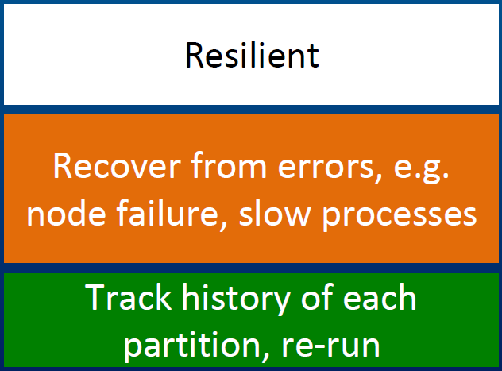
What is RDD?
Resilient Distributed Datasets or RDDs address this by enabling fault-tolerant, distributed, in-memory computations.

Slide 14
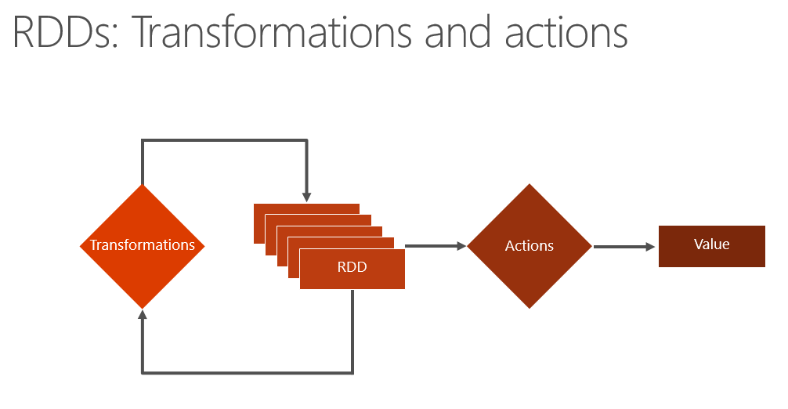
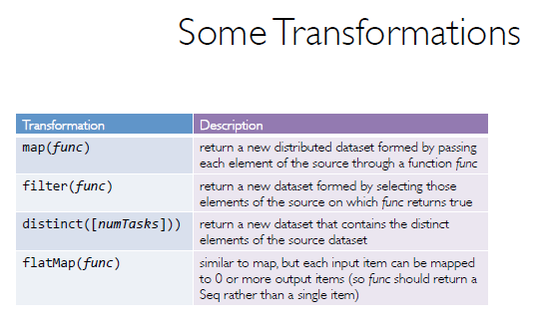
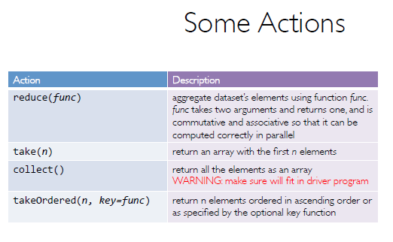
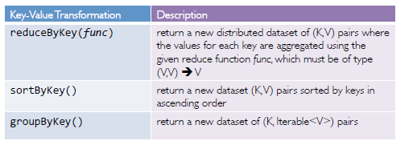
RDD Operations

Slide 15
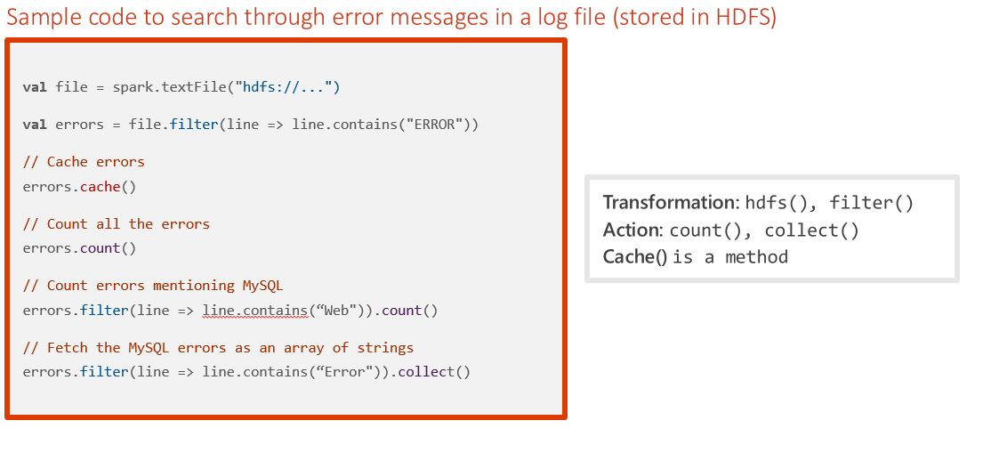
Transformations and actions: Sample code

Slide 16
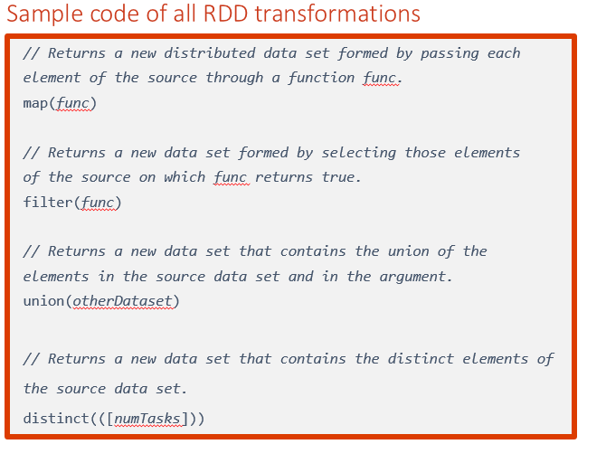
RDD transformations

Slide 17
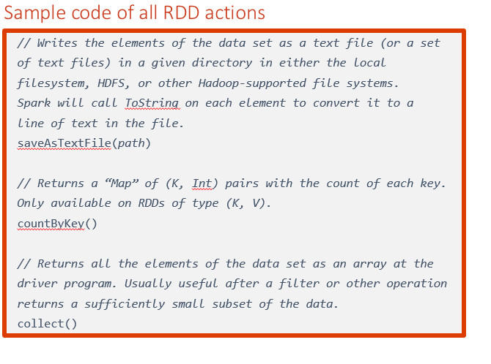
RDD actions

Slide 18
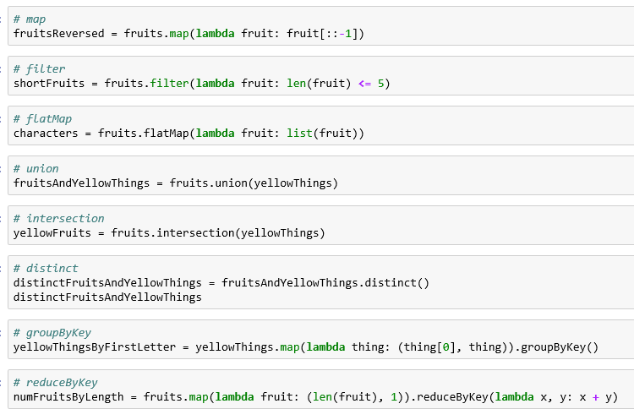
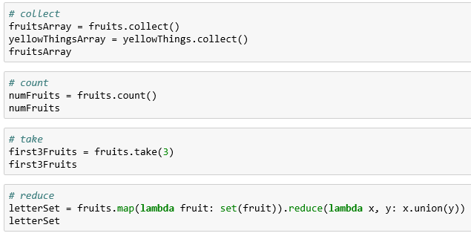
Demo: RDD
RDDs can be created from stable storage or by transforming other RDDs.
Transformations create a new dataset from an existing one. Transformations are lazy, meaning that no transformation is executed until you execute an action.
Actions return a value to the driver program after running a computation on the dataset.

Slide 19
What is DataFrames?
A distributed collection of data organized into named columns.
Similar to RDDs with schema.
Conceptually equivalent to tables in relational database, or to DataFrames in R/Python.
With domain-specific functions designed for common tasks:
Metadata
Sampling
Project, filter, aggregation, and join
UDFs
RDDs are a collection of opaque objects (such as internal structures unknown to Spark).
User
User
User
User
User
User
DataFrames is a collection of objects with schema that are known to Spark SQL..
Name
Age
Sex
Name
Age
Sex
Name
Age
Sex
Name
Age
Sex

Slide 20
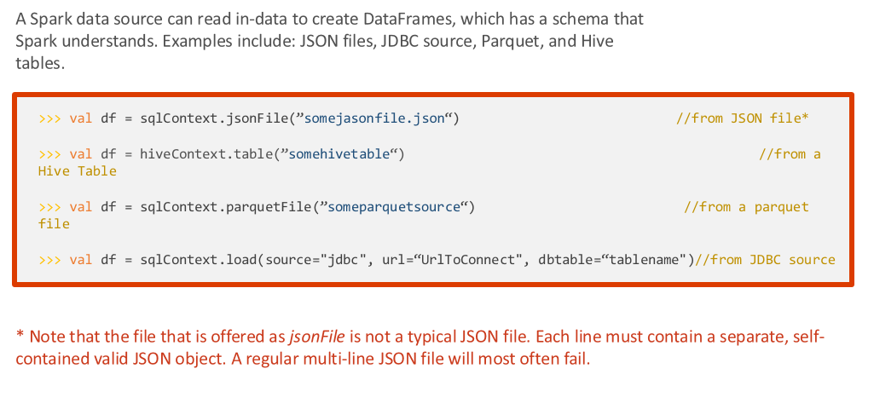
Creating DataFrames from data sources

Slide 21
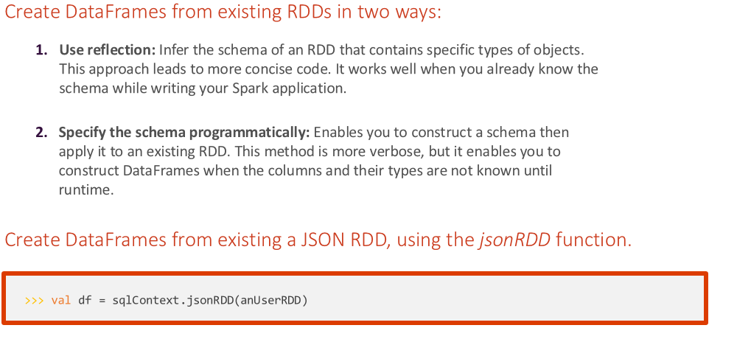
Creating DataFrames from RDDs

Slide 22
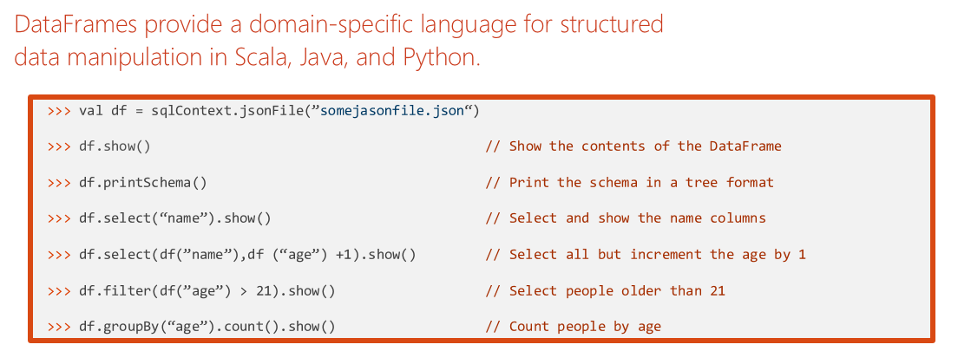
DataFrame Operations

Slide 23
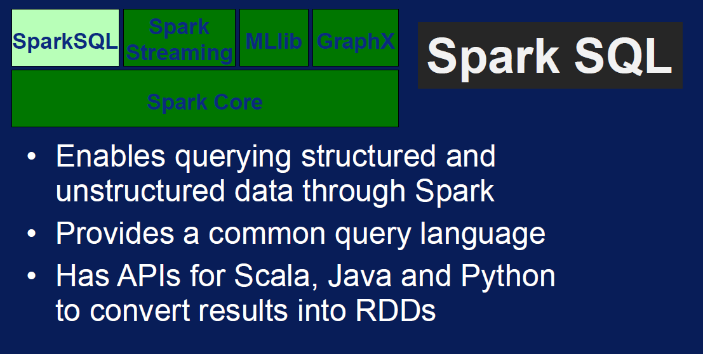
What is Spark SQL?
Create an Azure storage account
HDInsight makes Apache Spark available as a service in cloud.
Run Spark SQL statements using notebooks
1
2
3
HDInsight uses Azure Blob storage account for storing data.
HDInsight makes Apache Spark available as a service in cloud.
You run interactive Spark SQL statements using notebooks.

Slide 24
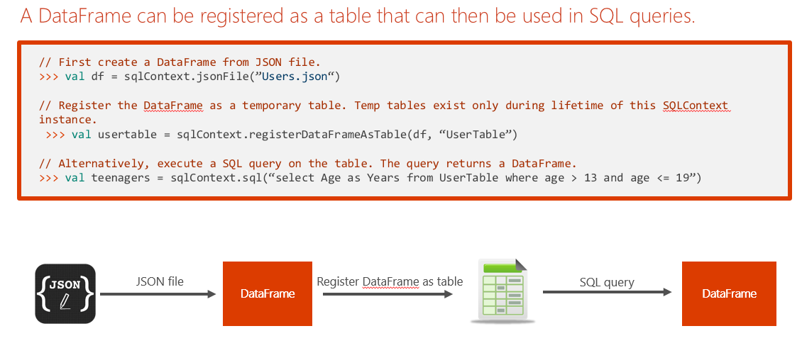
Tables and Queries

Slide 25
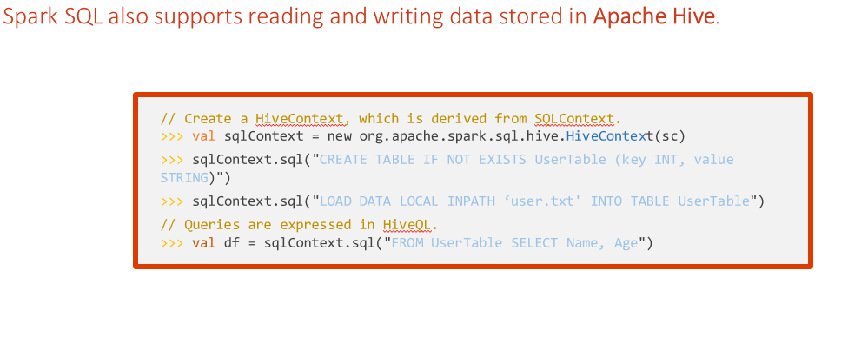
Hive tables

Slide 26

Spark SQL also supports reading and writing data stored in Apache Hive.
// Create a HiveContext, which is derived from SQLContext. >>> val sqlContext = new org.apache.spark.sql.hive.HiveContext(sc)
>>> sqlContext.sql("CREATE TABLE IF NOT EXISTS UserTable (key INT, value STRING)")
>>> sqlContext.sql("LOAD DATA LOCAL INPATH ‘user.txt' INTO TABLE UserTable")
// Queries are expressed in HiveQL.
>>> val df = sqlContext.sql("FROM UserTable SELECT Name, Age")

Slide 27
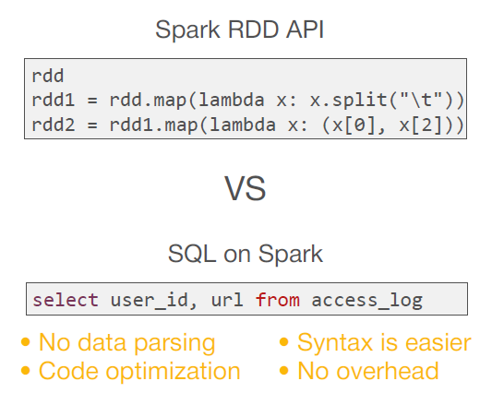
Spark SQL Operations

Slide 28
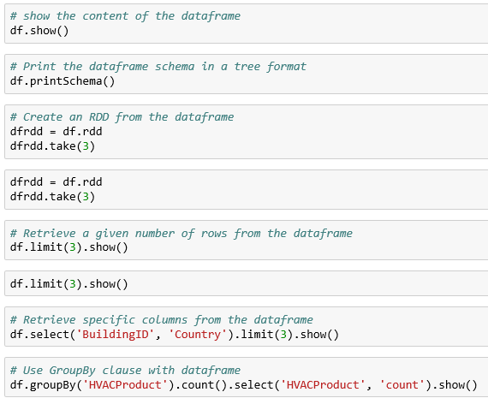
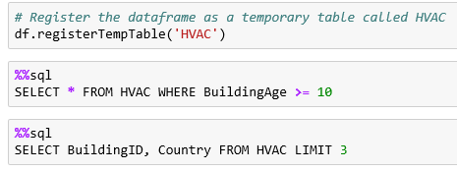
Demo: DataFrame and SQL
create a dataframe from a CSV file as shown below.
run SQL queries over dataframes once you register them as temporary tables within the SparkSession

Slide 29
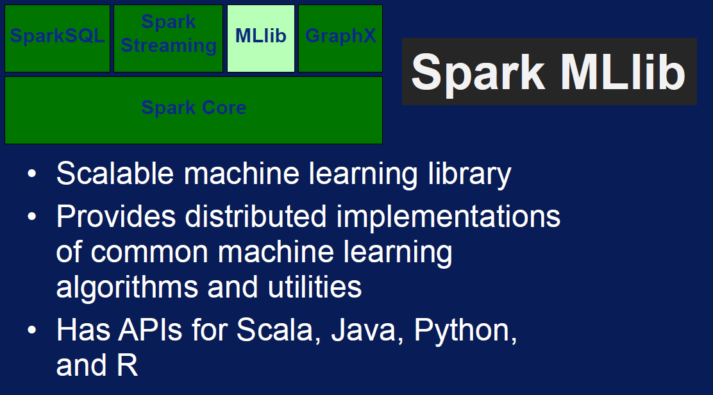
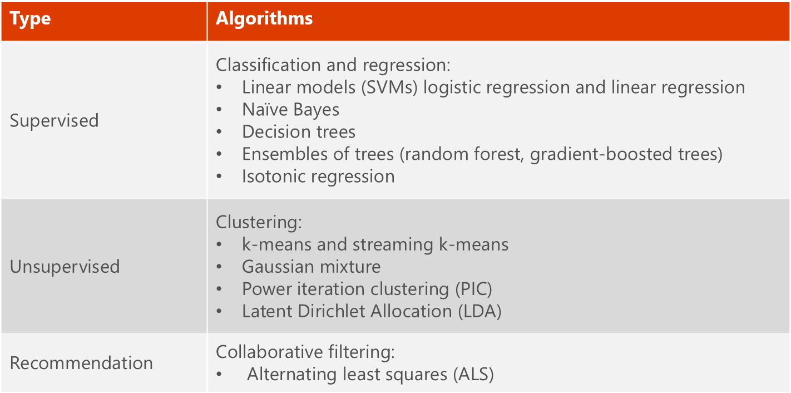
What is MLlib?
MLlib is a collection of machine learning algorithms optimized to run in a parallel, distributed manner on Spark clusters.
MLlib helps lead to better performance on large data sets.
MLlib integrates seamlessly with other Spark components.
MLlib applications are developed in Java, Scala, and Python.

Slide 30
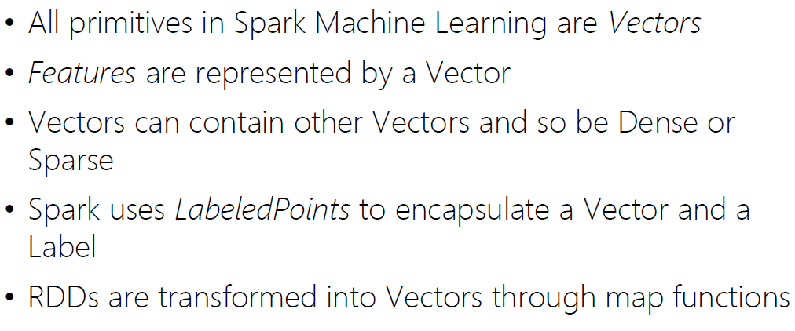
How to.. Machine Learning in Apache Spark?

Slide 31




MLlib Terminology

Slide 32



Example: Classification I
Step 2: Load Source Data
Step 3: Prepare the Data

Slide 33



Example: Classification II
Step 4: Split the Data
Step 5: Prepare the Training Data
Step 6: Train a Classification Model

Slide 34


Example: Classification III
Step 7: Prepare the Testing Data
Step 8: Test the Model

Slide 35



Example: Regression I
Step 2: Load Source Data
Step 3: Prepare the Data

Slide 36



Example: Regression II
Step 4: Split the Data
Step 5: Prepare the Training Data
Step 6: Train a Regression Model

Slide 37


Example: Regression III
Step 7: Prepare the Testing Data
Step 8: Test the Model

Slide 38



What is Pipeline?

Slide 39



Example: Pipeline
Step 1: Define the Pipeline
Step 2: Run the Pipeline as an Estimator
Step 3: Test the Pipeline Model

Slide 40



Example: Text Analysis
Step 2: Run the Pipeline as an Estimator
Step 3: Test the Pipeline Model

Slide 41



Example: Clustering
Step 1: Create the K-Means Model
Step 2: Get the Cluster Centers
Step 3: Predict Clusters

Slide 42



Example: Recommendation I

Slide 43


Example: Recommendation II

Slide 44

Questions

